Slide 1



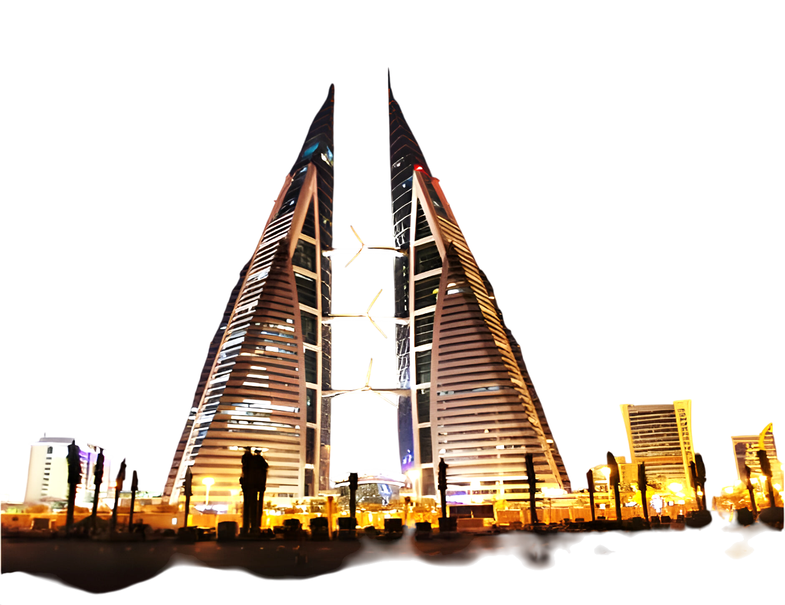





COMPANY PROFILE
2026
BAHRAIN OFFICE :
Bldg. 2317, Road 2830 Block 428, Al Seef District
P.O. Box 17110 Kingdom of Bahrain
Tel - + 973 -39634887, +973 -17000486
Email : sales@whitepearlsbh.com
www.whitepearlsgroup.com

Slide 2

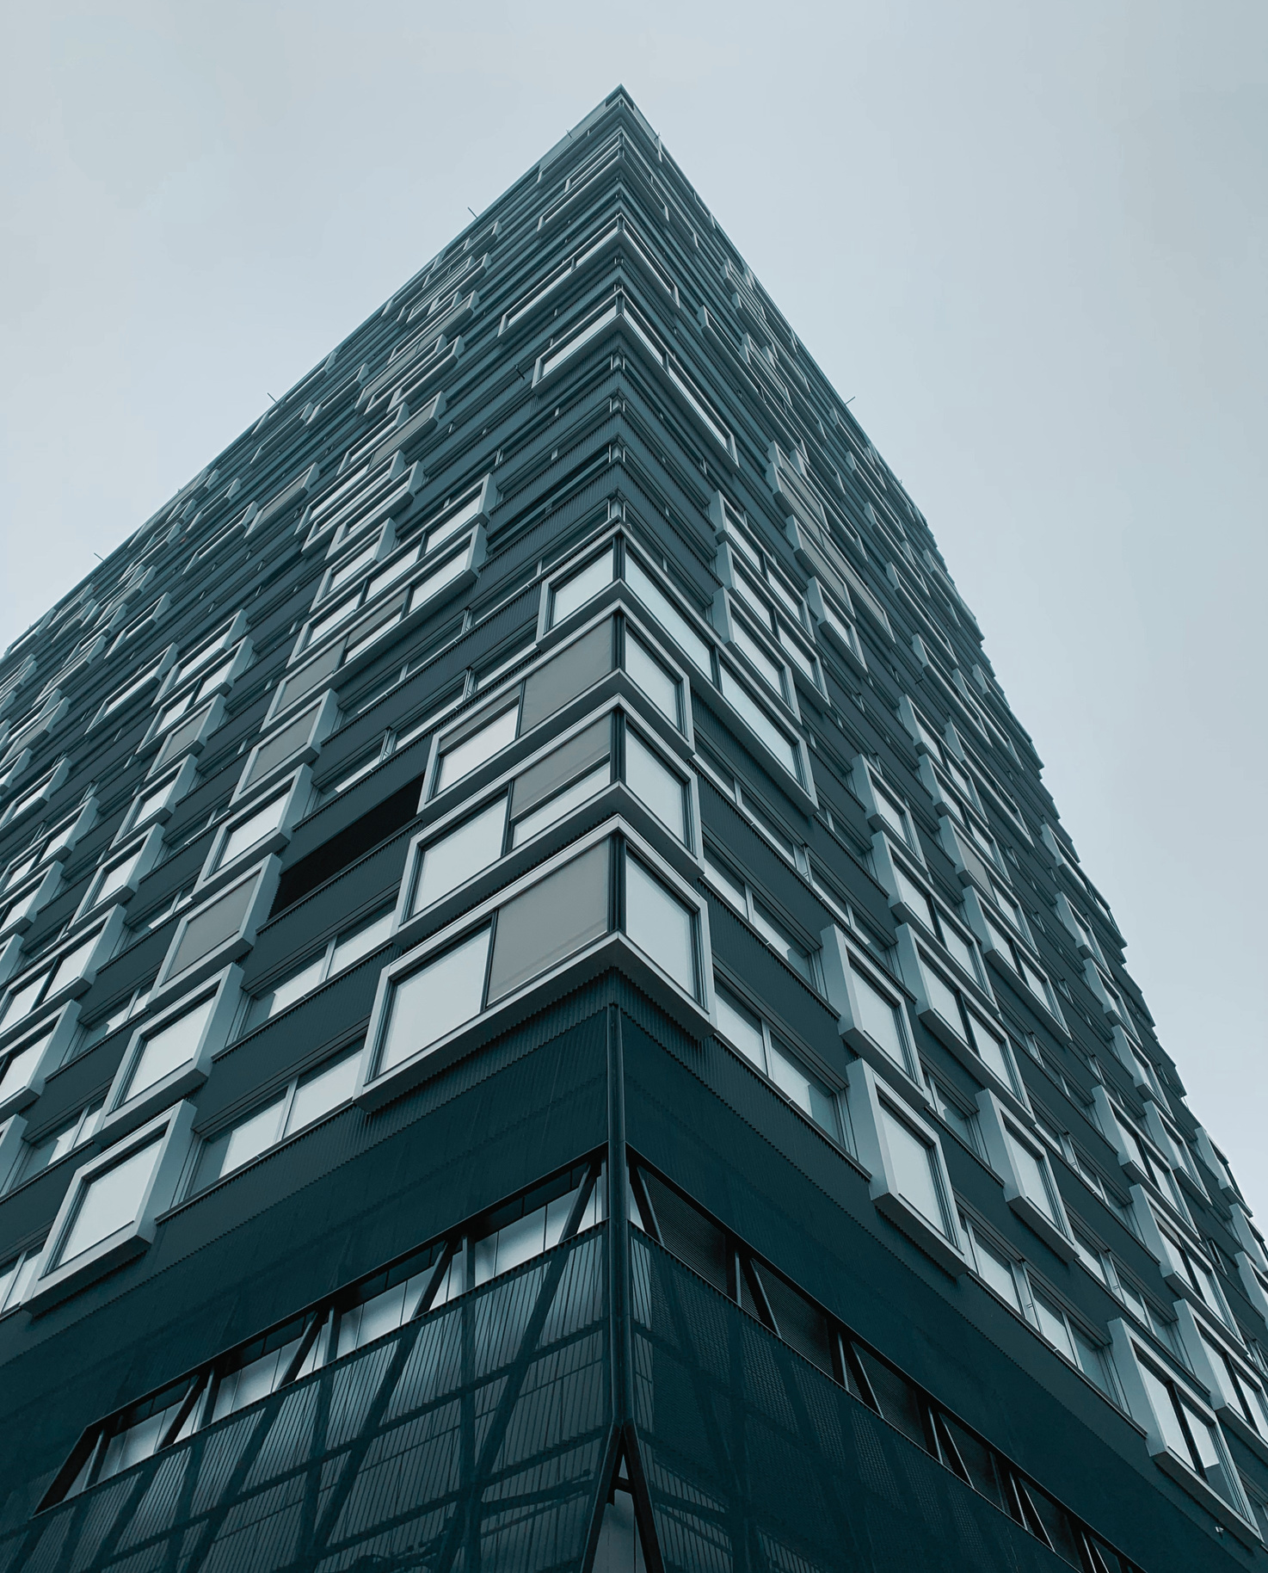


TABLE OF
CONTENTS
About Company
03
ISO Certifications &
EHS Training
04
Our Mission, Our
Expertise
05
What We Do
06
Quality Control & Assurance
07
Core Competencies, Core Value,
Core Strength
08
Projects
09
Our Clients
10
Partners
11
Find Us
12

Slide 3


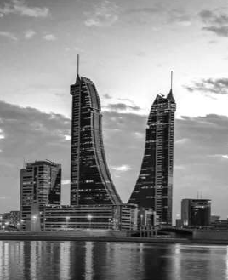


ABOUT
COMPANY
White Pearls is an ISO-certified group of companies established in 2013, operating across the KSA, Bahrain, and Indian markets. Built upon the foundational principles of teamwork, integrity, and commitment, we possess a diversified portfolio encompassing the Telecom, Construction, and Education sectors.
Our dedicated team of experts and experienced consultants specializes in telecommunication wireless & fixed networks, smart solutions, IoT, construction, electrical, and solar power. This extensive expertise enables us to handle a comprehensive range of projects within these fields.
At White Pearls, our team is driven by our founder's vision to deliver exceptional value to our customers, cultivate strong community partnerships, and consistently achieve optimal results.

Slide 4






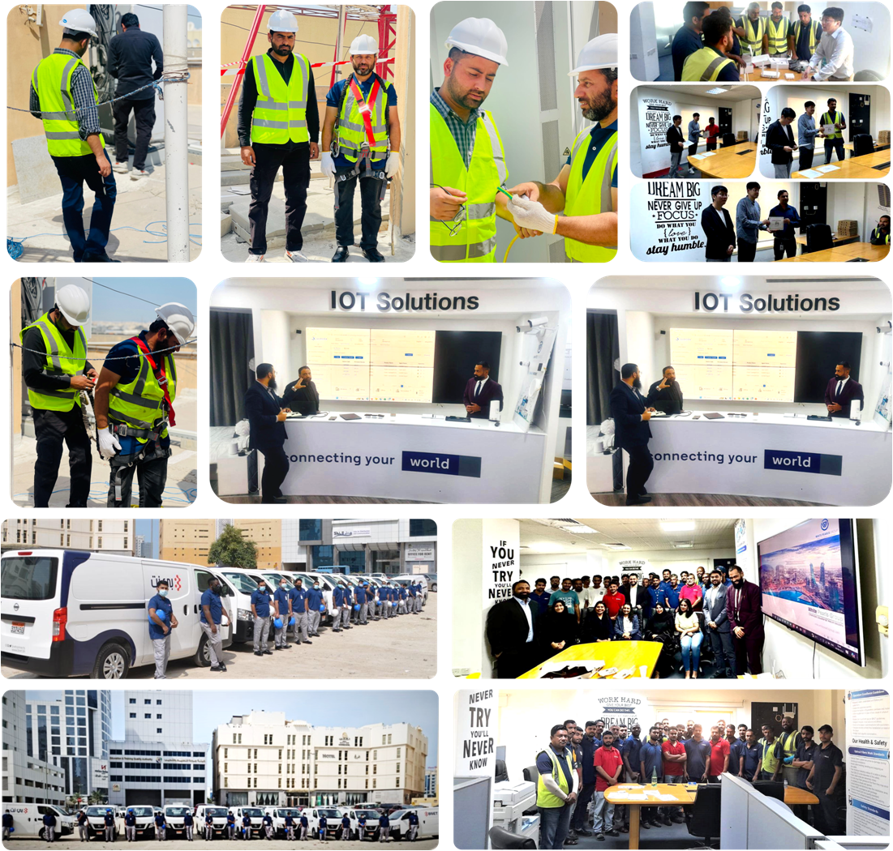
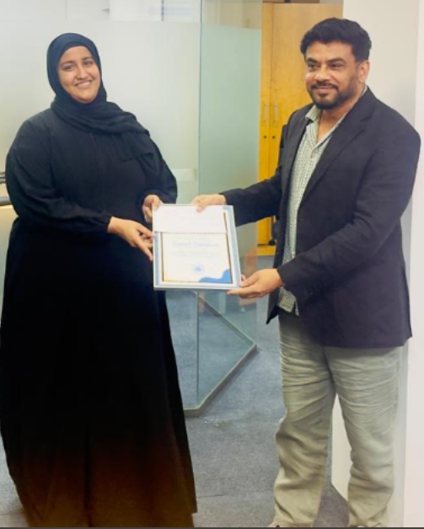
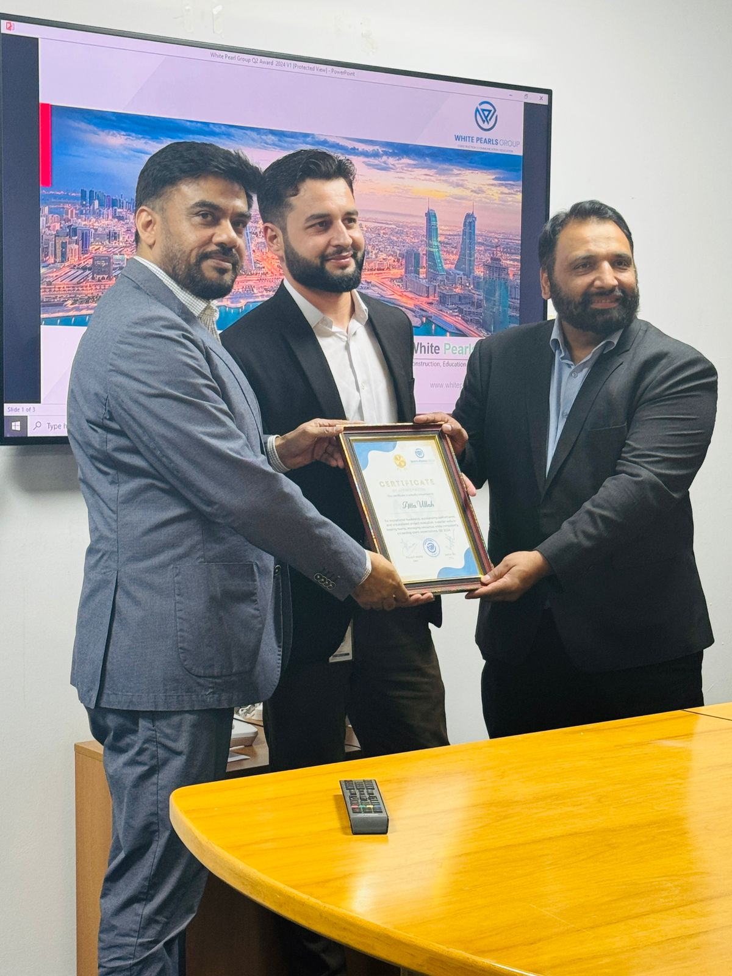
ISO Certifications
EHS & Products Trainings

Slide 5

Our Expertise
Group has expert teams and experienced Consultants in the fields of telecommunication - wireless & fixed network, smart solutions, IoT, construction, electrical and education, which enable us to handle almost all kinds of work in respective fields.
Our Mission
Our mission to serve our customers with best of quality, State of art workmanship, creating out most customer satisfaction leading to peace of mind.

Slide 6

WHAT WE DO
We leverage our technical expertise, extensive experience, and innovative resourcefulness to deliver state-of-the-art services in accordance with international delivery standards. Our service portfolio encompasses Telecom, ICT, RPA & AI, Security, Smart Solutions, Solar Energy, Education, and Construction.
ICT Consultants / HR Outsource
Telecom (Fixed and Mobile Network) Delivery & Assurance
Turnkey Site Solutions Civil Work & Electrical Work
ICT Infrastructure – Design & Technical Consultancy
Supply of Telecom infra, CPE, Routers Signal Boosters etc.
Robotic Process Automation & Artificial Intelligence
System Integration , Cyber Security Solutions
Smart Campus and IoT Design & Solutions
O&M for fixed and Mobile Network

Slide 7




At White Pearls Group (WPG), Quality Control (QC) and Quality Assurance (QA) are integral to every project phase, guaranteeing that all products and services meet client specifications and established standards. We implement rigorous inspections, including verification of supplier materials before installation and strict internal controls for on-site execution. Our commitment to quality is upheld by our team of certified technicians, who also benefit from regular training as part of WPG's core culture.
CORE
Wireless and fixed network installation services.
Telecom Towers & Sites Solutions, Civil Works including Tower Fabrication for telecom sites.
RF Drive testing. In-building solution DAS Design and installation.
Structure cabling, WiFi APs and FIBER optic works.
Consultation– NOC digitalization, Field Sales, Service and Workforce Management, Radio Planning
Data Center's – Access Control, Monitoring and supply & installation services.
Design and build construction projects.
Electrical and Grounding works of buildings and Telecom towers.
Shelters fabrication and supply of shelters customized as per customer requirements
Structural analysis & study of existing Towers and recommendations as per load requirements.
Design and implementation of Solar Projects.
Smart & Secure City and Smart home solutions.
RPA & AI System Integration for Ease of Access and 24x7 Operations ICT
System Integration & HR Outsourcing

Slide 8
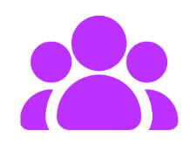




OUR
CORE VALUES
We Are Bold
We dare to try.
We Are Open
We work together with
collective strength.
We Are Demanding
We are always willing to go the extra mile.
We Are Caring
We build an environment based on trust and respect.
OUR
STRENGTH
Our main strength is our Human Resource which includes, not limited to -
No. of Project Managers (PMP Certified) – 4
No. of Telecom Engineers (Ericsson / Huawei / Nokia System Capable) – 8
No. of Engineers for Fixed Network – 8
No. of Supervisors / Technicians – 65
(Fixed & Mobile Network & IT )
No. of Riggers – 4
No. of Vehicles (Includes Sedan, Mini Bus, Pickup, etc.) – 75+
Material Storage Facility – 2 warehouses
For medium & Large scale projects
Additional Logistics and Warehouse facility - as per Project Requirements

Slide 9
Projects
Some of Successful Projects Brief
Telecom Equipment Installation (Huawei & Ericsson) – Various Customers
Structure Cabling Building Fiberization (10000+) Buildings (MDU) - BNET
Client Indoor Shelter to Outdoor Enclosure Swap Project, site dismantling – Batelco
Fiber tray installations - BNET
Delivery and Assurance for consumers, {Al Dana (VVIP) and Enterprise } – BNET BATELCO
WiFi, Structure cabling & CCTV planning and installation – Various Customers
Mobile Site Civil Works project including acquisition, foundation and Erection – STC & BTC
Electrical & Grounding Works (AC / DC) – Various Customers & Batelco
Structure analysis and Tower strengthening Projects - STC
Core & Fixed Network Installation – BNET, STC
Supply and installation of Telecom Shelters – Various Customers
TOWER and Camouflage Tower Solutions –Batelco
Excavate, Manhole & Slew Duct, Micro Duct, Fiber Optic Cable, Jointing, Splicing & Testing –BNET
Operation and Maintenance of Telecom Operations, Field Management, Out sourcing - BTC & BNET
LAN Infra Installation and commissioning - Al Baraka Hospital
Server installations and OS configuration - Gulf Hotel IT Project.
In Building Solution - DAS supply & installation (Multiple projects) – STC, Zain, Batelco and Others
Digital Signature Software Project (BFC)
P.S.: Details Project list been send as separate attachment

Slide 10

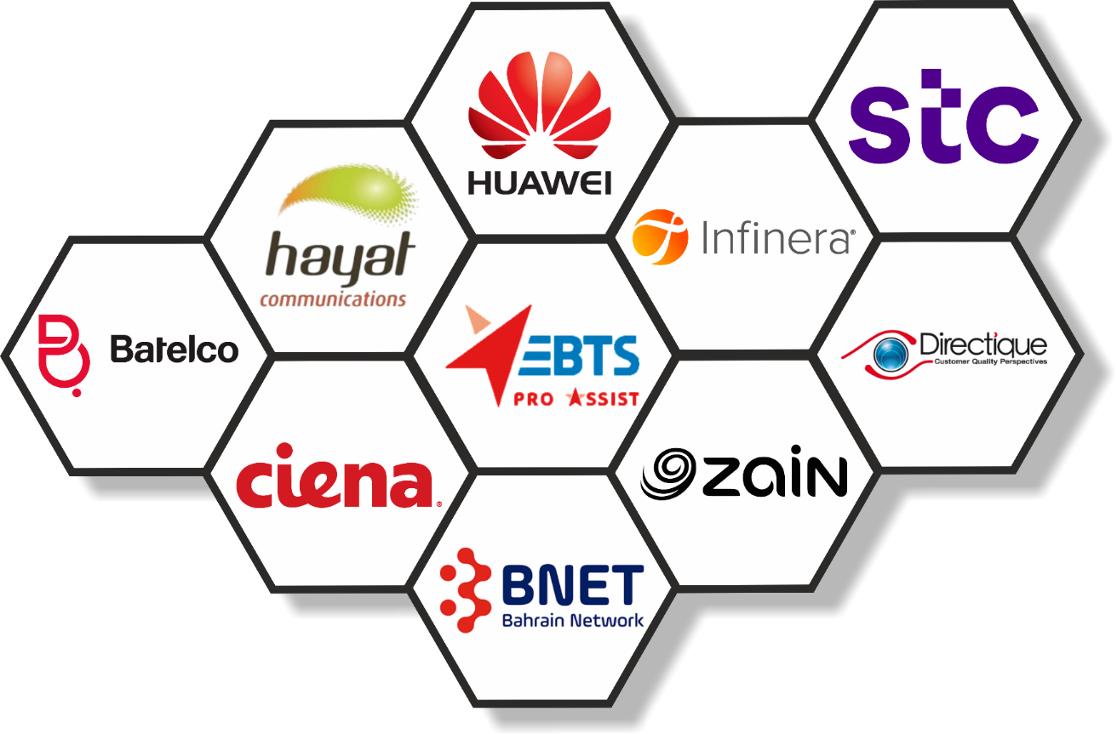







Our

Slide 11

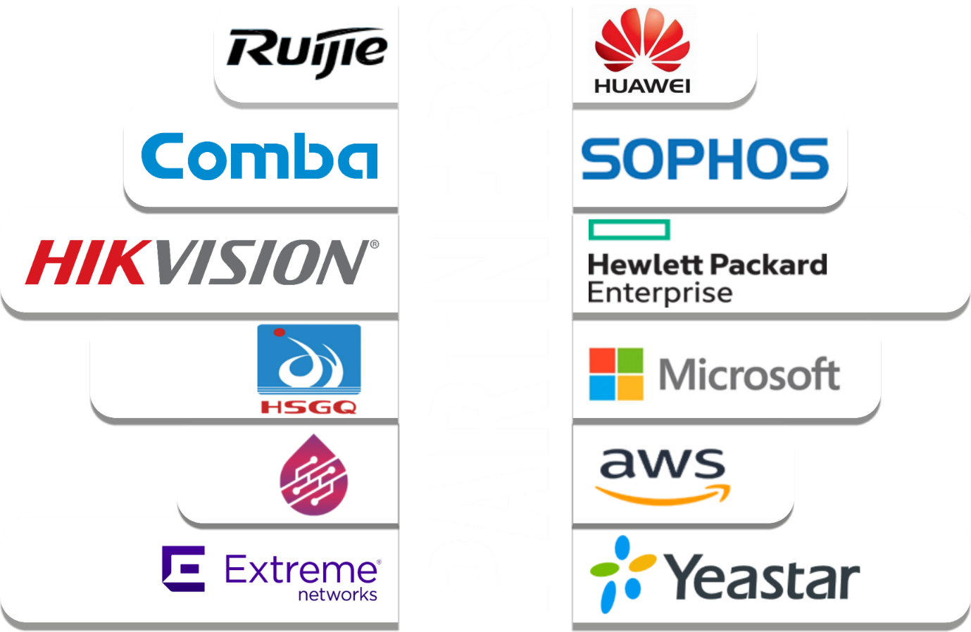








PARTNERS
Our
associates

Slide 12





BAHRAIN HQ :
Bldg. 2317, Road 2830 Block 428, Al Seef District
P.O. Box 17110 Kingdom of Bahrain
Tel - +973 -17000486
KSA OFFICE :
Dammam Tower 11th Street Building No: 7157
Zip code: 32416, Additional No: 2823
City: Dammam KSA
Tel : +966 553843588, 5736 4 4209
Oman OFFICE :
North Batinah Sohar,
Zip code: 32416,
Muscat, Oman
Singapore OFFICE :
160 Robinson Road #14-04 Singapore Business Federation Center,
Singapore, 068914 SG
Tel : +
India OFFICE :
Behind P.A.C. Head Quarter, Nakatiya Bareilly City: UP, India
Tel : +91 70171 19596, 95286 18002
Web : www.whitepearlsgroup.com , Email : sales@whitepearlsbh.com

